Slide 1

Impact of climate on bushfires in Australia
by Team Disney Donut
Notes:
Spyro

Slide 2
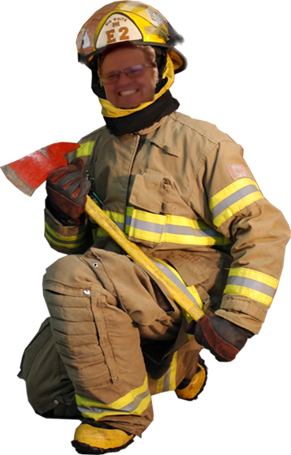

Bushfire safety presentation
Notes:
Jim

Slide 3
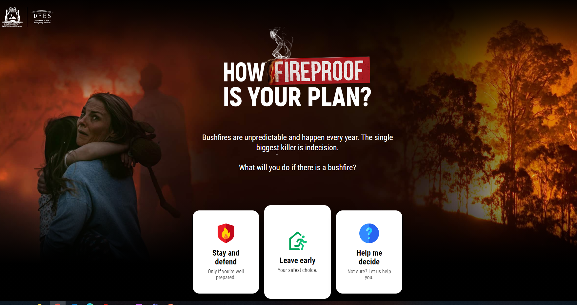
Bushfire Safety
https://mybushfireplan.wa.gov.au/
Notes:
Jim

Slide 4
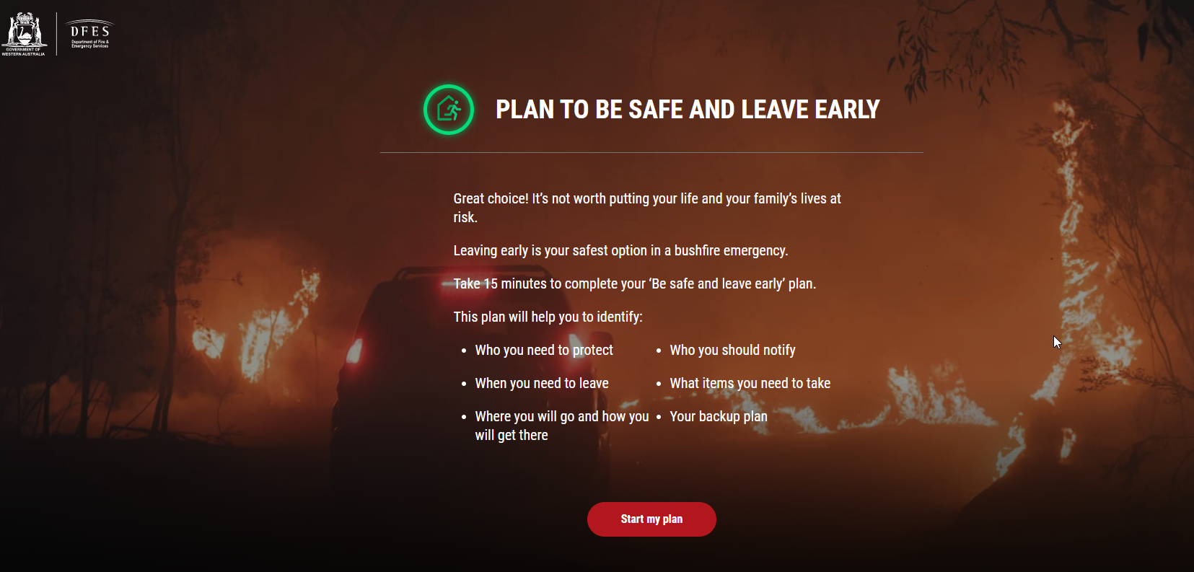
Bushfire Safety
https://mybushfireplan.wa.gov.au/
Notes:
Jim

Slide 5
Research question
How has the climate impacted the occurrence of bushfires in Australia?
How has climate change impacted the environment?
Notes:
COLLINS
Why this topic?
Interesting topic increasingly important for decades, at first glance correlations expected among multitudes of data
Also close to home with examples in the southern and eastern suburbs in the past two weeks

Slide 6
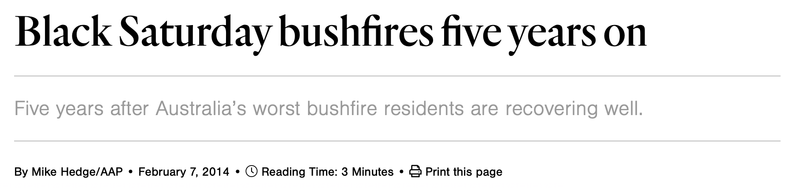
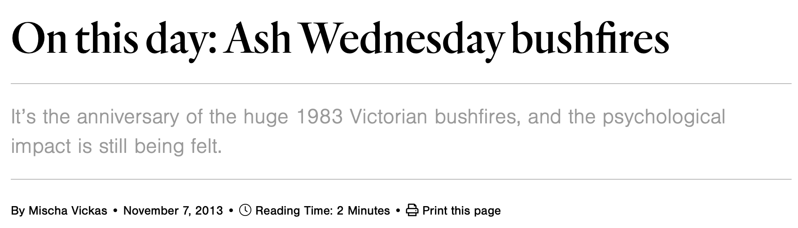
Notes:
COLLINS

Slide 7
Hypothesis
Climate change has increased the occurrence and severity of bushfires
There is a relationship between bushfires, GHG, rainfall, temperature and deforestation
Notes:
COLLINS
Relationship examples:
the frequency and severity of bushfires increases as GHG increase, rainfall decreases, temperature increases, deforestation increases
GHG increases temperature
Increase temperature decreases rainfall
A decrease in rainfall causes deforestation to increase

Slide 8
Data
Climate change is proxied by the following datasets:
Green house gasses
Level of rainfall across time
Temperatures
Level of deforestation
Bushfire incidents
Three biggest: CO2, CH4, N2O
Average p/year, total p/year & state
Average p/year
If crown cover >20% p/strata
Total ha burnt area & estimated value loss from bushfire incidents p/year
Notes:
THIERRY
- CO2 (carbon dioxide), CH4 (methane), N2O (nitrous oxide)

Slide 9
Challenges
Data in unusable format
Merged data unbalanced, different timeframes
Difficulty finding good open and consolidated sources
Statistical testing was very bland
Notes:
THIERRY
The team had to be creative to find other proxies for climate change that can be used to complete the project and answer the hypothesis question.
Data sets, which may be a good indicator of climate change, are also often not in a useable format, for example only reported every 5 years.
The data was an unbalanced panel, some series go all the way back to 1920 while others only go back to 1990 and doesn’t provide data up to 2020.
Difficulty finding good open sources, for example, geographic spatial bushfire data produced by NASA and data.gov.au. Bushfire data is often note open and consolidated – emergency fire department in each state produces their own data.
Statistical testing was very bland, which can affect the statistical significance of the results.
At the end, the team traded simplicity and efficiency to complete the project.

Slide 10
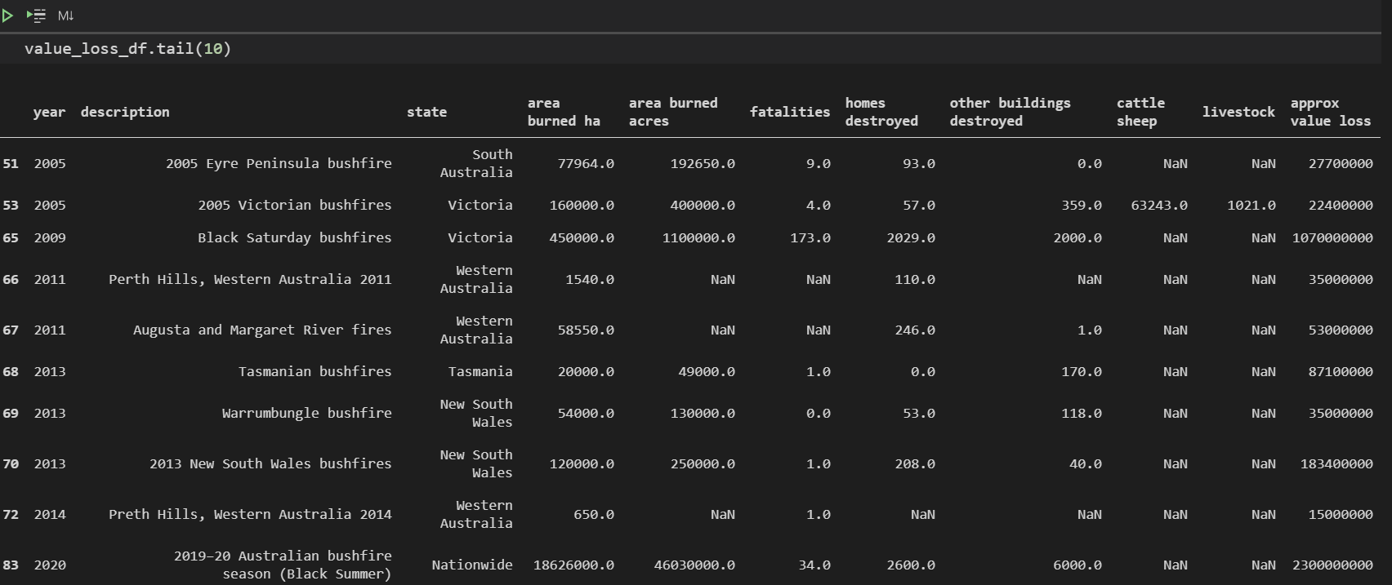
Notes:
THIERRY

Slide 11
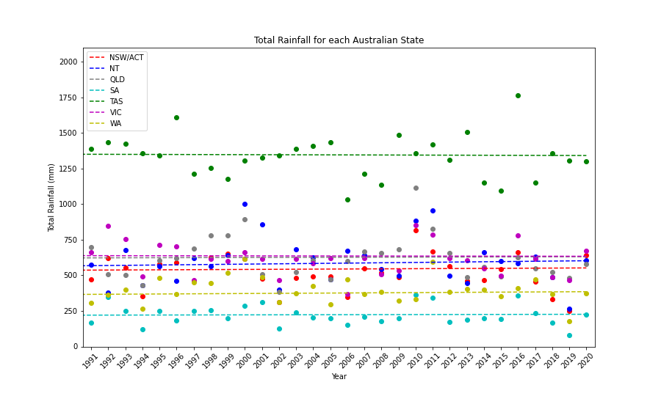
Findings: Rainfall
The long-term average rainfall is consistent, while yearly averages can differ significantly
Notes:
THIERRY

Slide 12
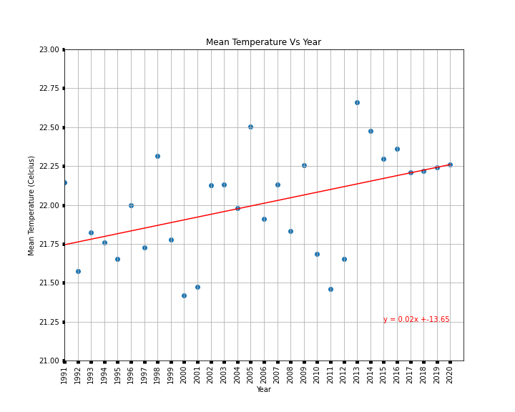
Findings: Temperature
Average Temperature in Australia is on the rise over time
Notes:
JIM

Slide 13
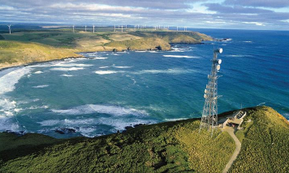
Findings: Emissions
The latest greenhouse gas (GHG) data updated monthly from one of the cleanest air sources in the world
Notes:
JIM
Cape Grim - Tasmania

Slide 14
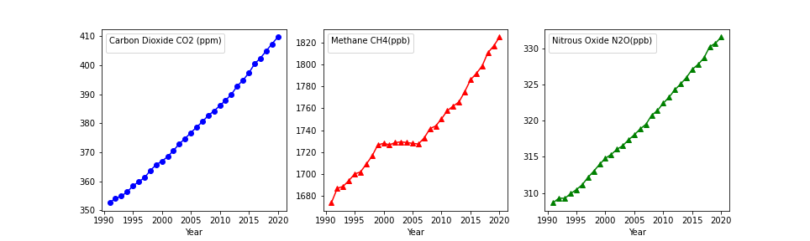
Findings: Emissions
Notes:
JIM

Slide 15
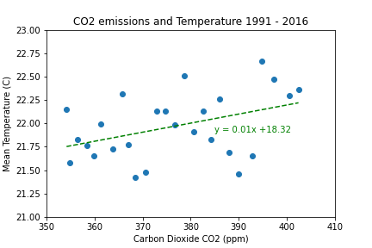
Findings: Temperature v Emissions
Temperature and emissions increase slowly over time
Moderately positive relationship with R² = 0.4
Notes:
JIM

Slide 16
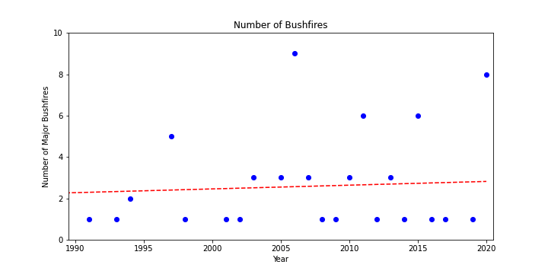
Findings: Bushfires
The data does not show more bushfires over time
But it feels like we experience one almost every year
Notes:
VANESSA

Slide 17
Most hectares burnt
Ranking | year | description | state | area burned ha
1 | 1975 | 1974-75 Australian bushfire season | Northern Territory | 45,000,000
2 | 1970 | 1969-70 Dry River-Victoria River fire | Northern Territory | 45,000,000
3 | 1968 | 1968-69 Killarney Top Springs bushfires | Northern Territory | 40,000,000
4 | 2002 | 2002 NT bushfires | Northern Territory | 38,000,000
5 | 1975 | 1974-75 Australian bushfire season | Western Australia | 29,000,000
6 | 1975 | 1974-75 Australian bushfire season | South Australia | 16,000,000
7 | 1975 | 1974-75 Australian bushfire season | Queensland | 7,300,000
8 | 2020 | 2019–20 Australian bushfire season (Black Summer) | Northern Territory | 6,800,000
9 | 2020 | 2019–20 Australian bushfire season (Black Summer) | New South Wales | 5,500,000
10 | 1851 | Black Thursday bushfires | Victoria | 5,000,000
11 | 1975 | 1974-75 Australian bushfire season | New South Wales | 4,500,000
12 | 1952 | 1951–52 bushfires | Victoria | 4,000,000
13 | 2020 | 2019–20 Australian bushfire season (Black Summer) | Queensland | 2,500,000
14 | 1985 | 1984 - 85 New South Wales bushfires | New South Wales | 2,484,000
15 | 2020 | 2019–20 Australian bushfire season (Black Summer) | Western Australia | 2,200,000
16 | 2003 | Tenterden | Western Australia | 2,110,000
17 | 1957 | 1957 Grose Valley bushfire, Blue Mountains | New South Wales | 2,000,000
18 | 1939 | Black Friday bushfires | Victoria | 2,000,000
19 | 1961 | 1961 Western Australian bushfires | Western Australia | 1,800,000
20 | 2020 | 2019–20 Australian bushfire season (Black Summer) | Victoria | 1,500,000
Notes:
VANESSA

Slide 18
Findings: Bushfires
Average rain fall does not have a significant statistical impact to average hectares burned due to bushfires
Notes:
VANESSA
Recorded rain levels could be much later when or even before the fires started, not providing respite to emergency services and assisting with fighting fires.

Slide 19
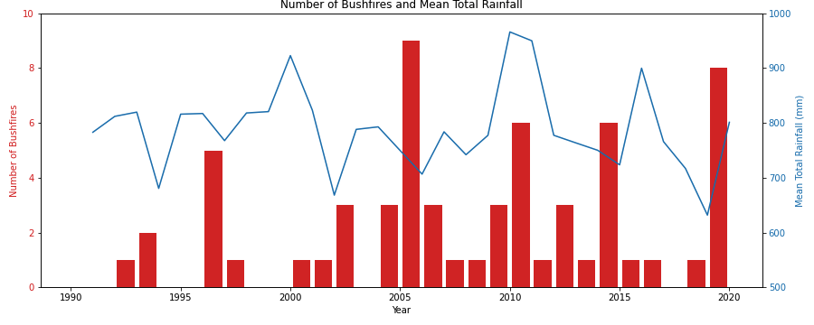
Findings: Bushfires
Observation for long-term average shows consistent average rainfall.
Mean total rainfall varies significantly each year
Notes:
VANESSA
Recorded rain levels could be much later when or even before the fires started, not providing respite to emergency services and assisting with fighting fires.

Slide 20
Further Research - Climate
Climate change = complex!
Further research into our variables
Notes:
SPYRO

Slide 21
Further Research - Bushfires
Bushfires also affected by:
Wind speed – burn time and fire containment
Other weather factors – i.e. cyclones
Where it starts and travels – i.e. towards bushland / residential area, emergency services personnel access
Level of fuel load on forest floor
Frequency of burn-offs during off peak fire season
Notes:
SPYRO

Slide 22
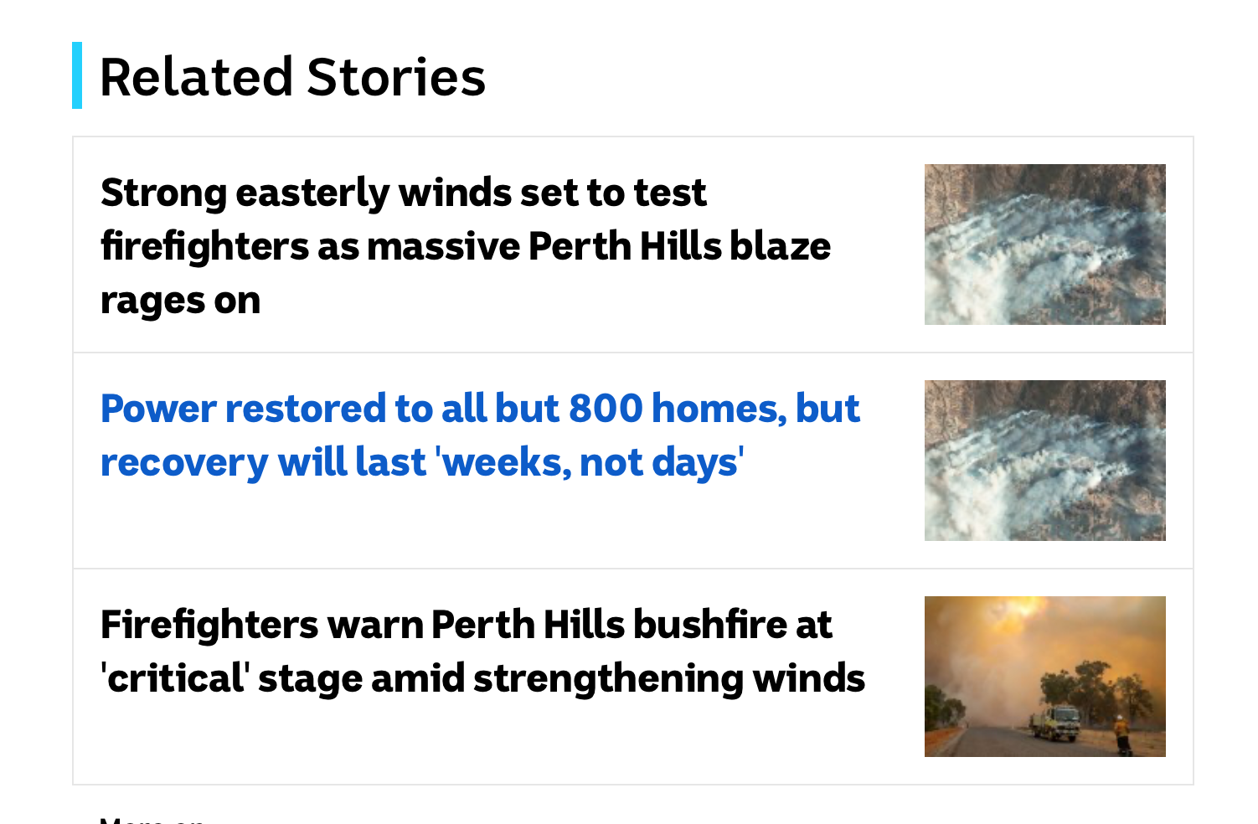
Notes:
SPYRO

Slide 23
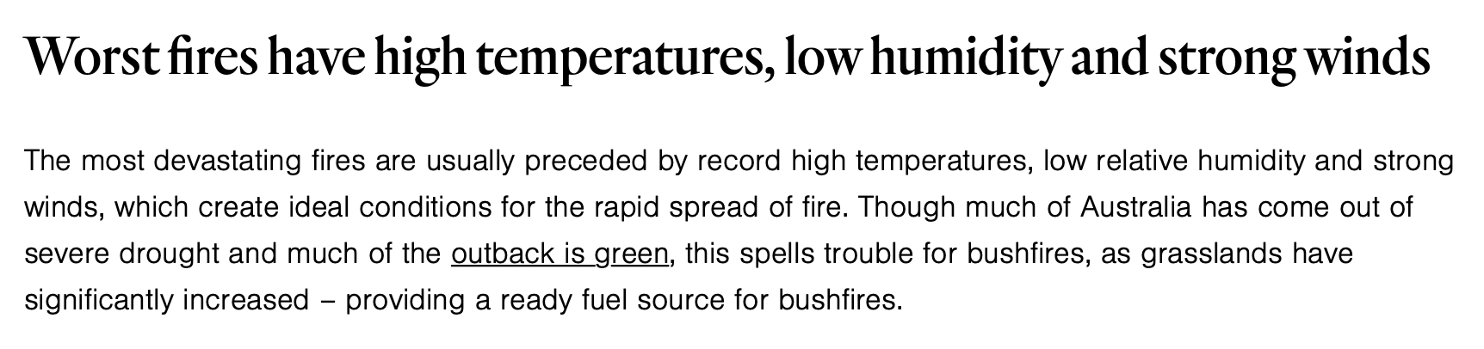
Notes:
SPYRO

Slide 24

Thank you

Slide 25
References
Temperature – Climate Knowledge Portal (World Bank)
Green House Gasses – CSRIO
Rain fall
Climate Knowledge Portal (World Bank)
Bureau of Meteorology (Australia)
Deforestation – Australian Department of Agriculture, Water and Environment
Bushfires – Wikipedia, Fire Departments website across Australia, Newspapers

